Slide 1
Machine Vision: From Raw Pixels to
Autonomous Decisions
The mathematica[ foundations of Convolution, Filtering, and Image Restoration.

Slide 2
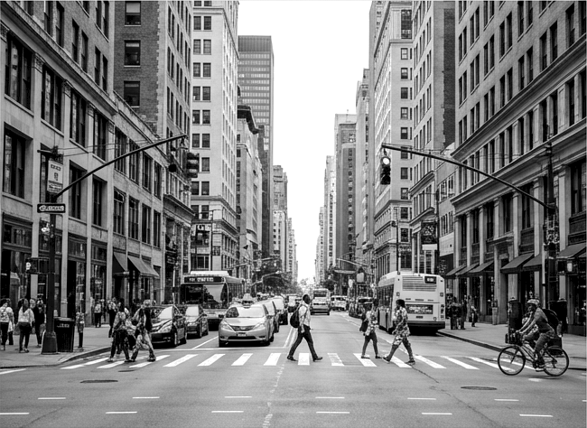
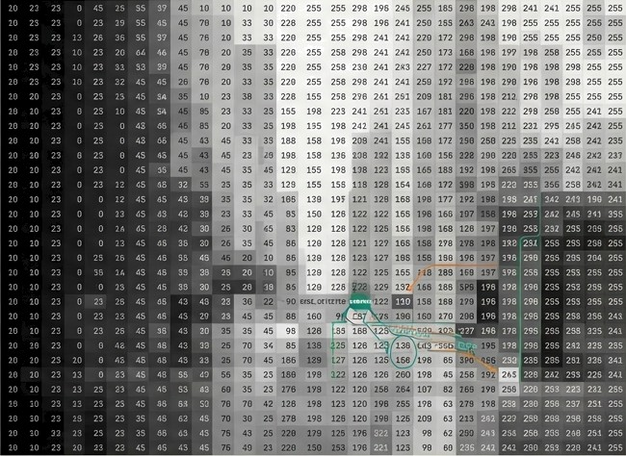
Robots Do Not Understand Pictures. They Process Arrays of Numbers.
HUMAN PERCEPTION ROBOT PERCEPTION
Insight: Before a robot can make a decision, it must bridge the gap between noisy sensor input and clean data. These techniques clean, enhance, and connect images befone decisions ane made.

Slide 3
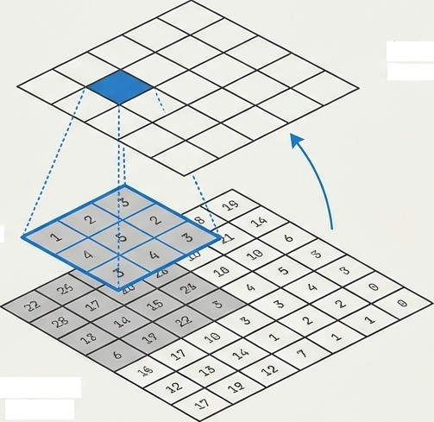
Convolution is the Atomic Unit of Image Processing
Engineering Editorial
DEFINITION:
A mathematical operation that applies a small matrix (Kernel) to an 1mage to mod1fy 1t .
WHY IT MATTERS: The
underlying mechanism
for blurring, sharpening,
and edge detection.
Output
Feature Map
Filter / Kernel
Input Image
(Pixels)

Slide 4
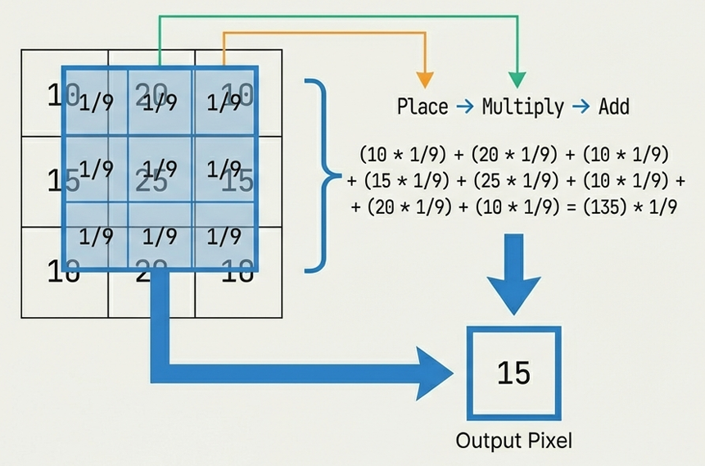
The Mechanics of the Sliding Window
STEP-BY-STEP:
1. PLACE: Align the kennel
over the image pixels.
FIULTIPLY: MuTtip1y
overlapping pixel values
with kernel values.
ADD: Sum the results.
OUTPUT: Place final value
in the new image array.
NOTE: Example shorn : Average Filter (Blur). By
averaging
inage is
neighbors, the
smoothed .

Slide 5
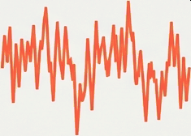
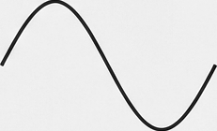

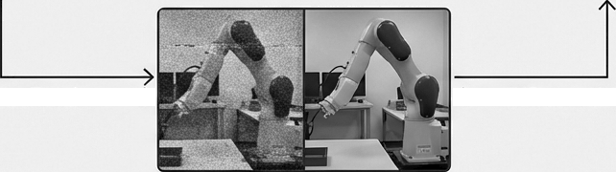
Filtering Transforms Chaos into Manageable Signals
Filtering modifies an
1nage by spec1f1cal1y
enhanc1ng or suppress1ng
Filten
(Convolution)
certain features . It is implemented mathematically using sonvolution.
Noisy Input
Clean Signal
Remove Noise (Grainy Data)
Enhance Edges
(Boundar1es)
Snooth Images
(Pre-processing)
Raw Feed
Filtered Feed

Slide 6
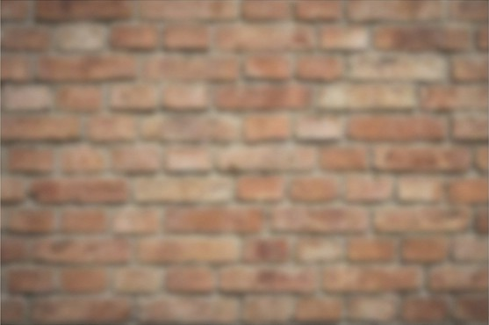
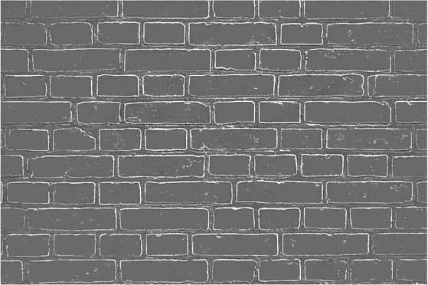
The Toolkit: Low-Pass vs. High-Pass Filtering
Low-Pass Filter (Gaussian Blur)
High-Pass Filter (Laplacian)
Function: Removes noise, smooths image. keeps low-frequency data.
Function: Enhances edges, highlights boundaries. Heeps high-frequency changes.
Crucial for Robotics: Low-pass cleans the view; High-pass finds the obstacles.

Slide 7
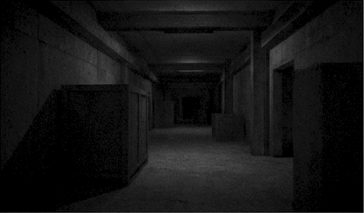
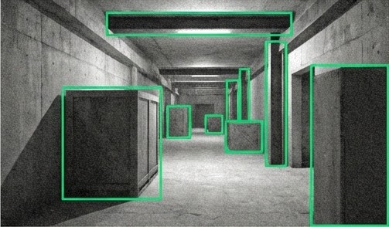
Image Enhancement: Optimizing for Interpretation
Goal: Improving visual quality for better interpretation.
hey Characteristic: Subjective. Depends on human or robot needs,
not a ground truth .
Brightness
Adjustment +
Contrast Stretch1ng
Raw, Low Contrast (N1ght V1sion)
Enhanced for Navigation
Robotic Application: Increasing brightness in dark environments allows
navigation algorithms to function.

Slide 8

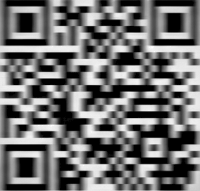



Image Restoration: Recovering the Original Truth
known errors.
Inverse F1Iter1ng /
Noise Modeling
Degraded Image (Notion Blur)
Robotic Application: Removing
Restored Image (Sharp, Scannable)
motion blur aTTows for accurate localization
even when the robot is moving at speed.

Slide 9
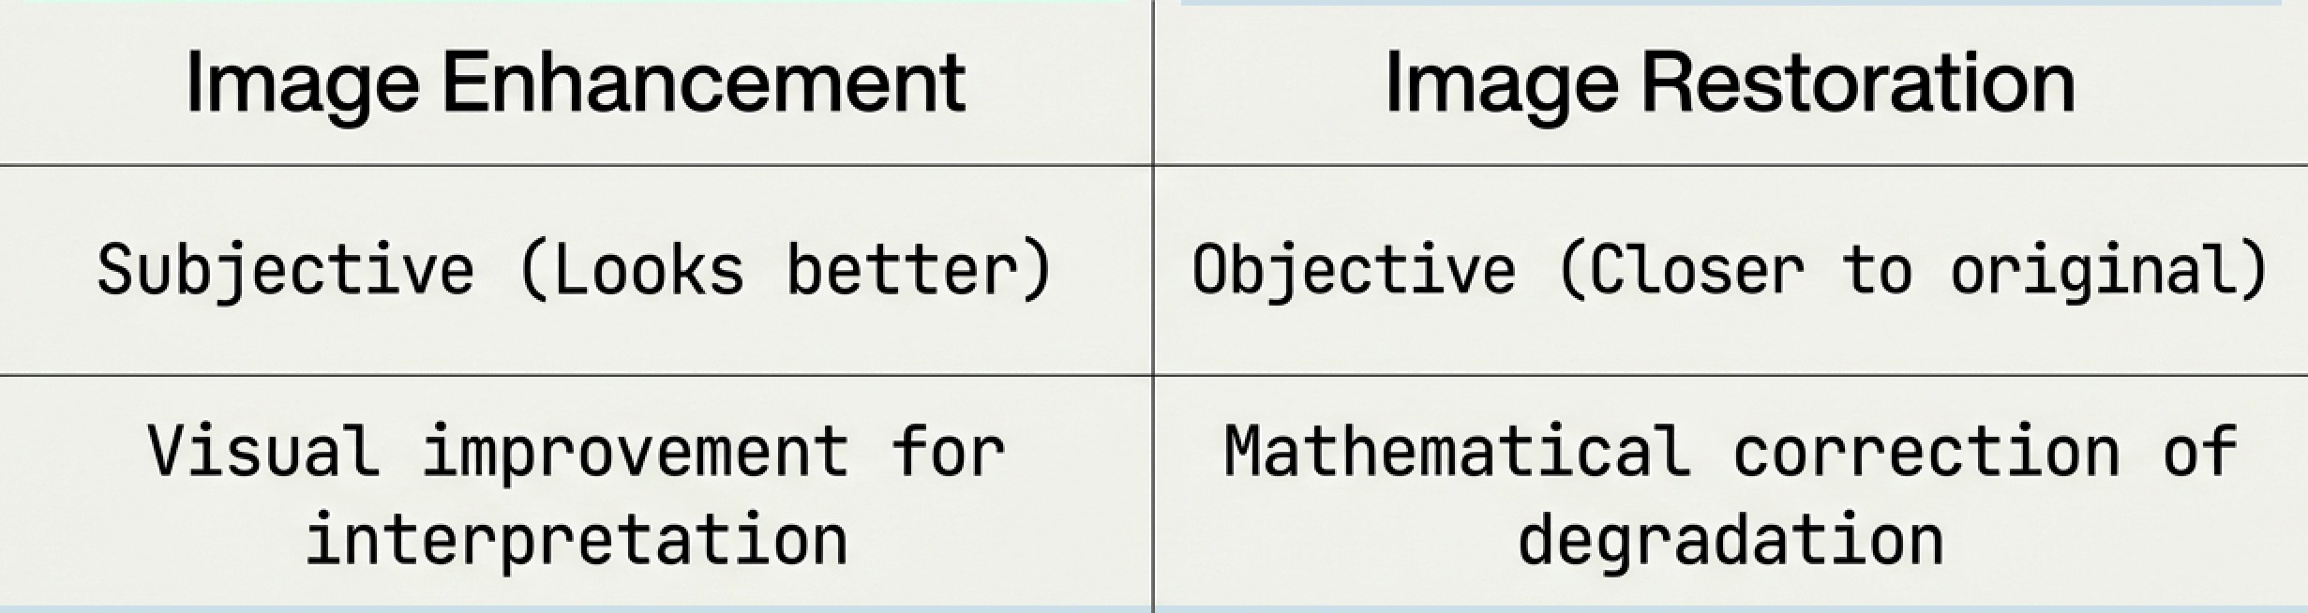
The Critical Distinction: Enhancement vs. Restoration

Slide 10
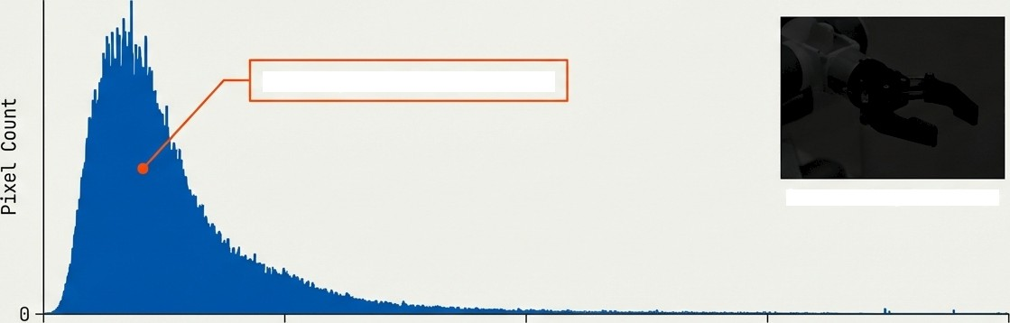
Histogram Processing: Decoding Light Distribution
A histogram maps the distribution of pixel intensity values. It is a diagnostic tool for robot vision.
Pixel Intensity Histogram
UndereKposed
/ Low Contrast
Corresponding Dark Inage
0
b4
128
Pixel Intensity (O=Black, 255=White)
192
255

Slide 11


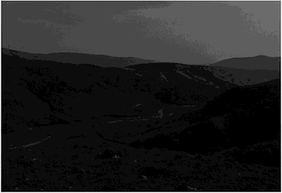
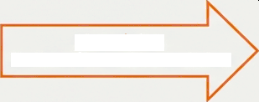
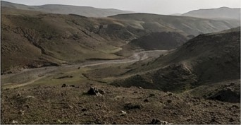
Automating Clarity with Histogram Equalization
Raw Input
Equalized Output
0
BE 100 1S0 200 2SS
0
H
100 150 200 25S
Algorithm: Redistribute Intensities
Essential for outdoor robots dealing with variable sunlight and deep shadows.

Slide 12


The Pipeline of Perception
Input Image (Raw Data)
This pipeline transforms chaotic sensory input into structured data a robot can trust.
Convolut1on + Filtering (Noise Removal, Edge Setup)
Image Enhancement / Restoration
(Correction & Recovery)
Histogram Processing (Light1ng Balance)
Output: Decis1on- Ready Data

Slide 13
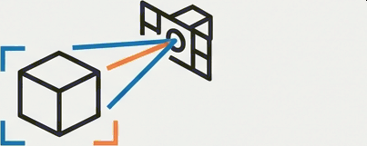
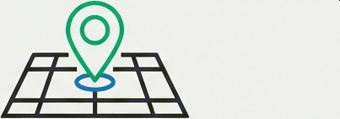
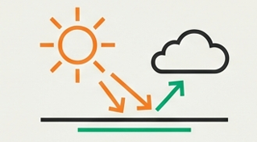
From Data to Decision
Cleaner Images
Better Obstacle
Detection.
Restored Data
Balanced Light
Accurate
Localization.
Reliable Outdoor
twigation.
These mathematical foundations are not just image manipulation; they are the prerequisites for autonomous interaction with the physical world.

